Slide 1
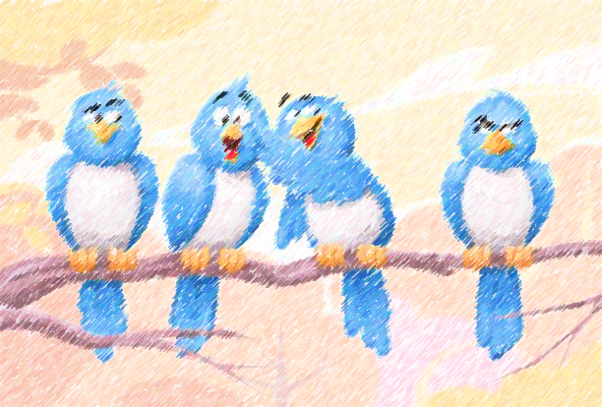
Welcome In Our Game ……

Slide 2
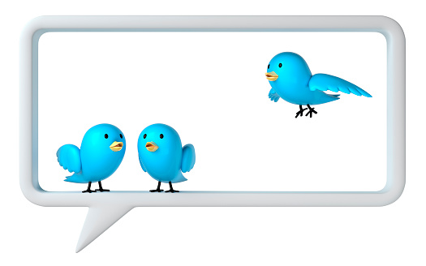
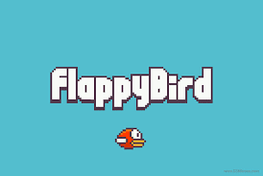
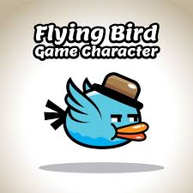
Name of Our group: The black hat .
Name of game: Flapping bird.
Team : Hiba El Farissi – Yassir Benjima .
The boss : Yassir Benjima .
Group : DEVOWFS 202.

Slide 3
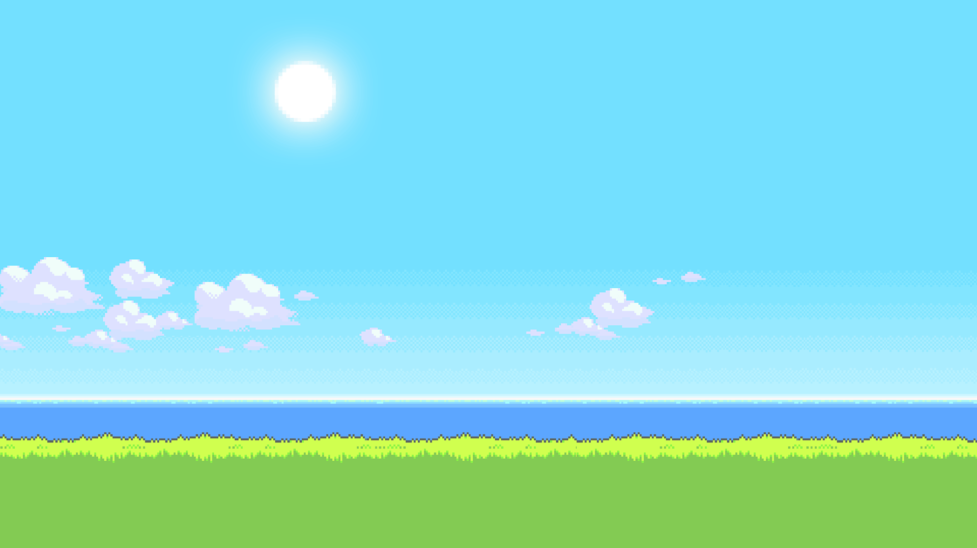
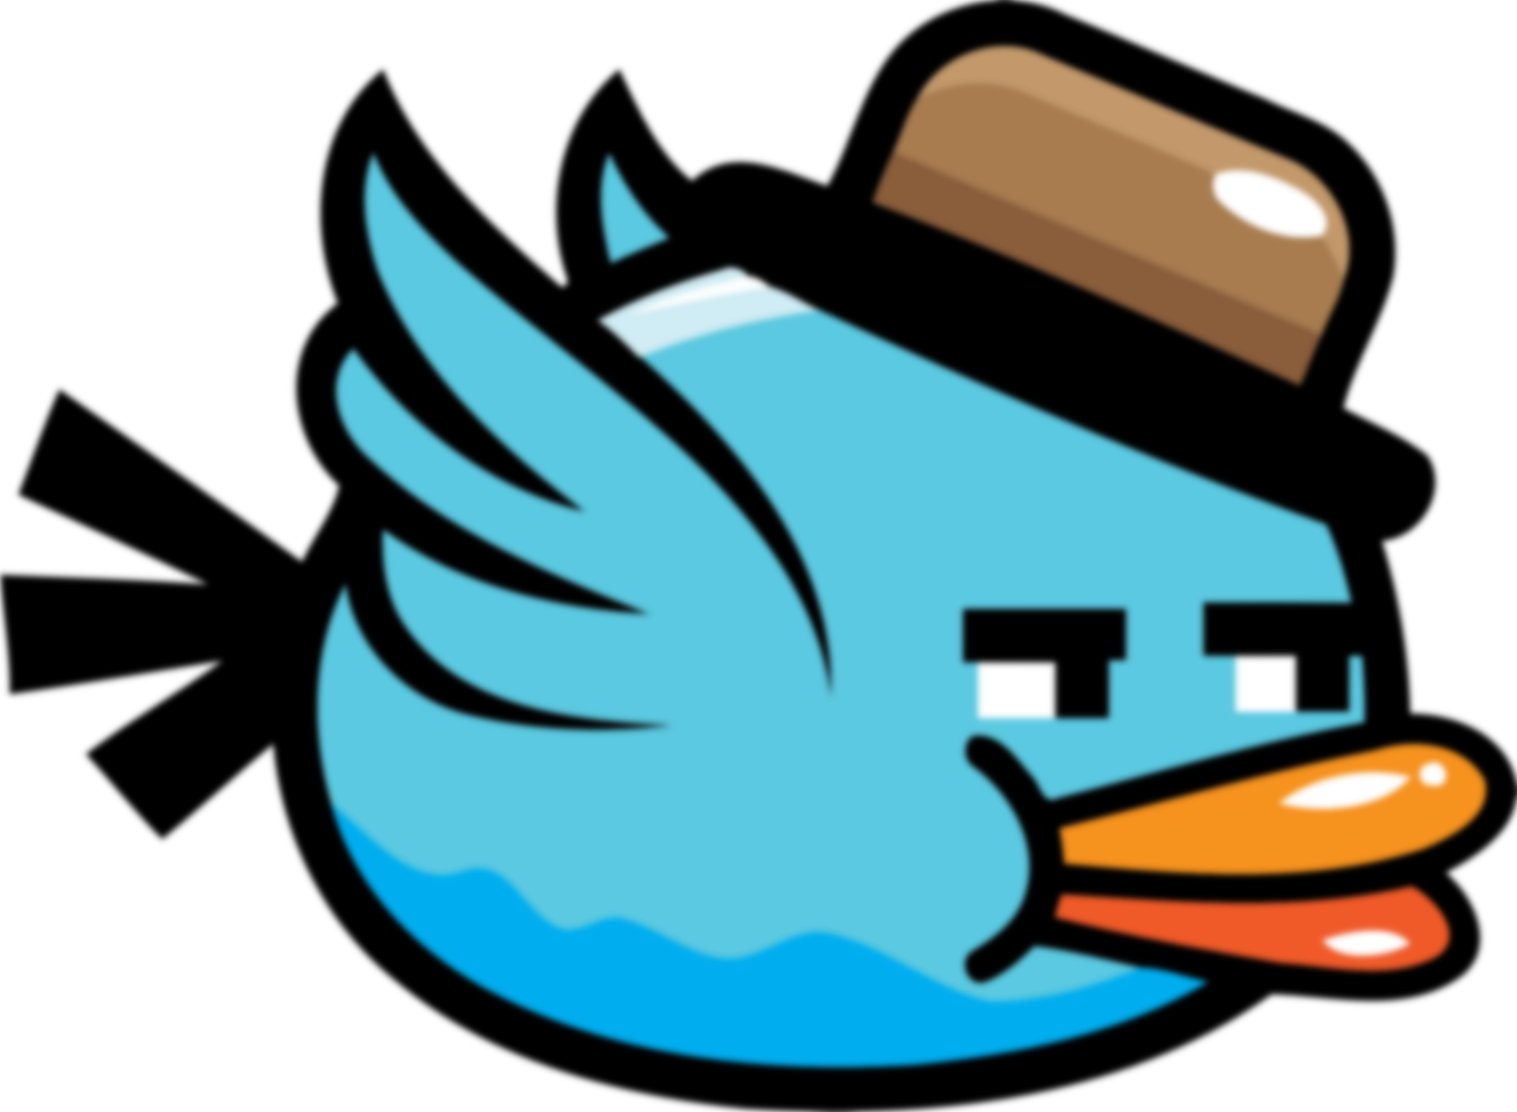
  What is the purpose of Flappy Bird game?
Flappy Bird is an arcade-style game in which the player controls the bird Faby, which moves persistently to the right. The player is tasked with navigating Faby through pairs of pipes that have equally sized gaps placed at random heights.

Slide 4
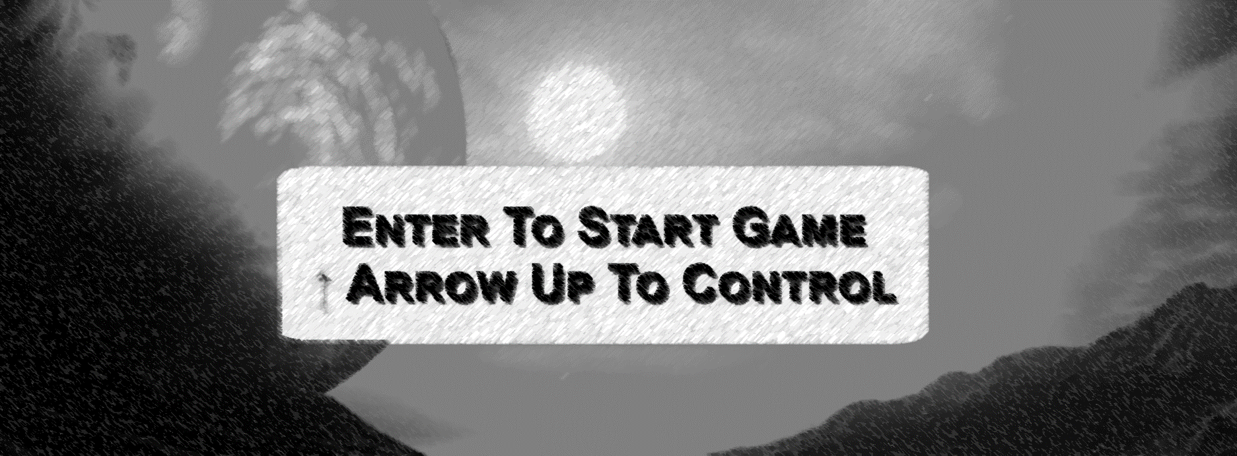
THE INTERFACE OF GAME

Slide 5
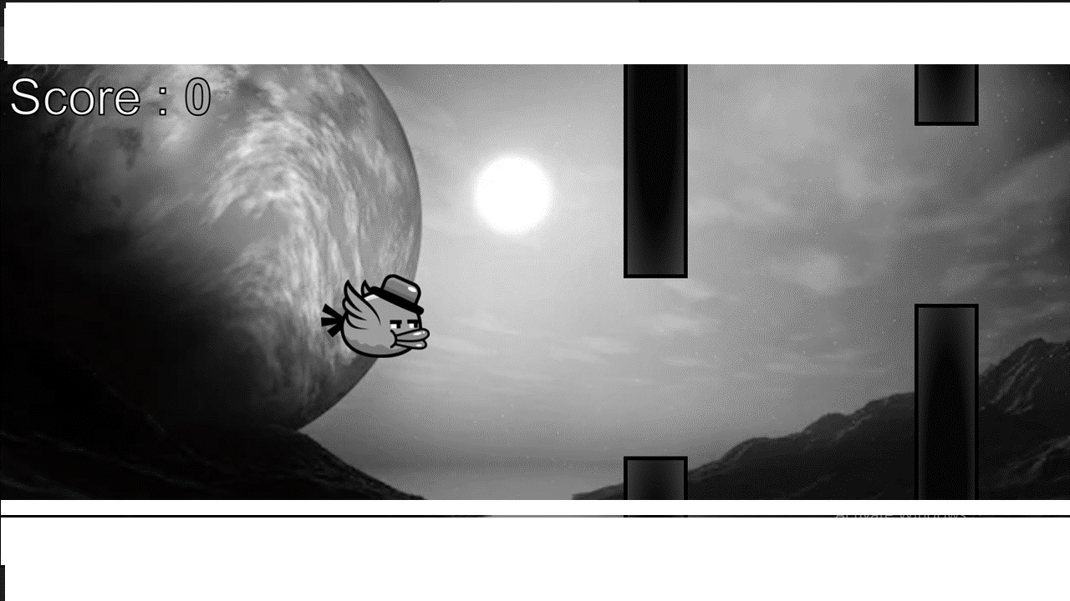

Slide 6
What makes Flappy Bird so addictive?
The premise (tap the screen to give the bird a bump of lift and then it glides downward as it moves across the screen) is simple, but the touchy controls, merciless gravity mechanics, )and the fact that even getting close to a pipe is enough to end the single life you have per round have made ...

Slide 7
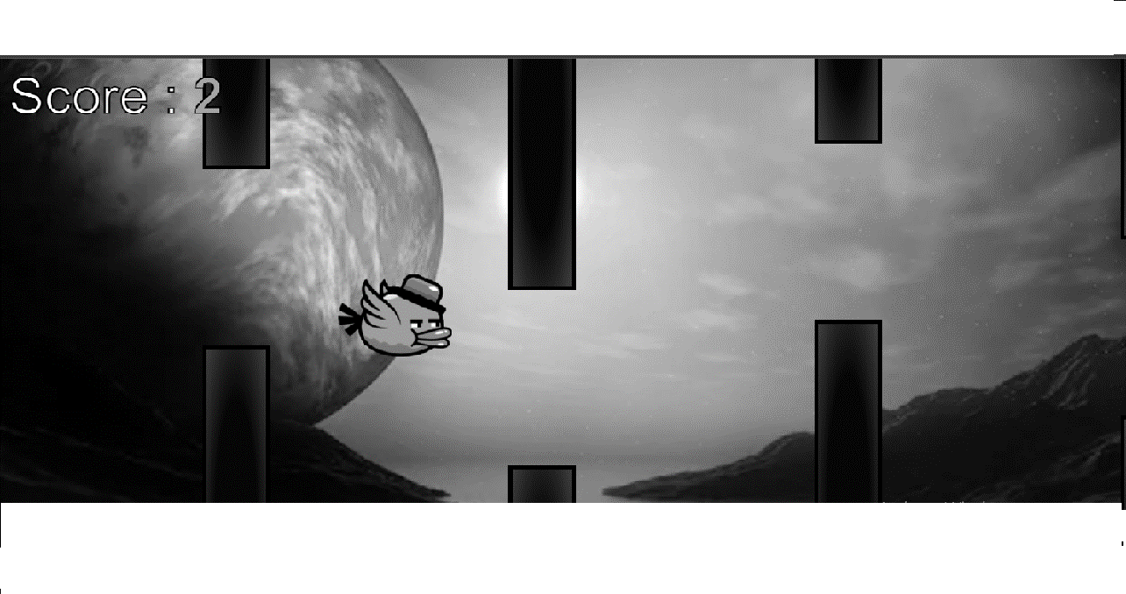

Slide 8
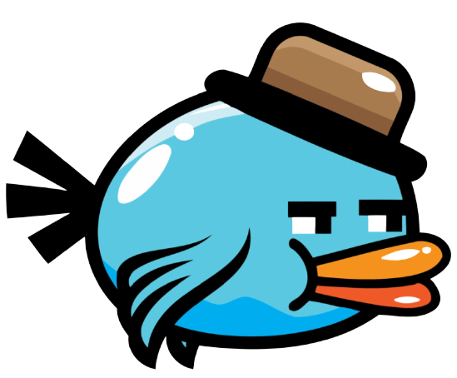
Why is scoring important in games?
Scoring systems largely determine how long players stay in a game
Is There an end to flappy bird ?
Flappy bird?
Well... There actually is an end. I have not made it there myself, but the highest number you can get is 9,999 or something like that. I have a ways to go before I ever get that

Slide 9
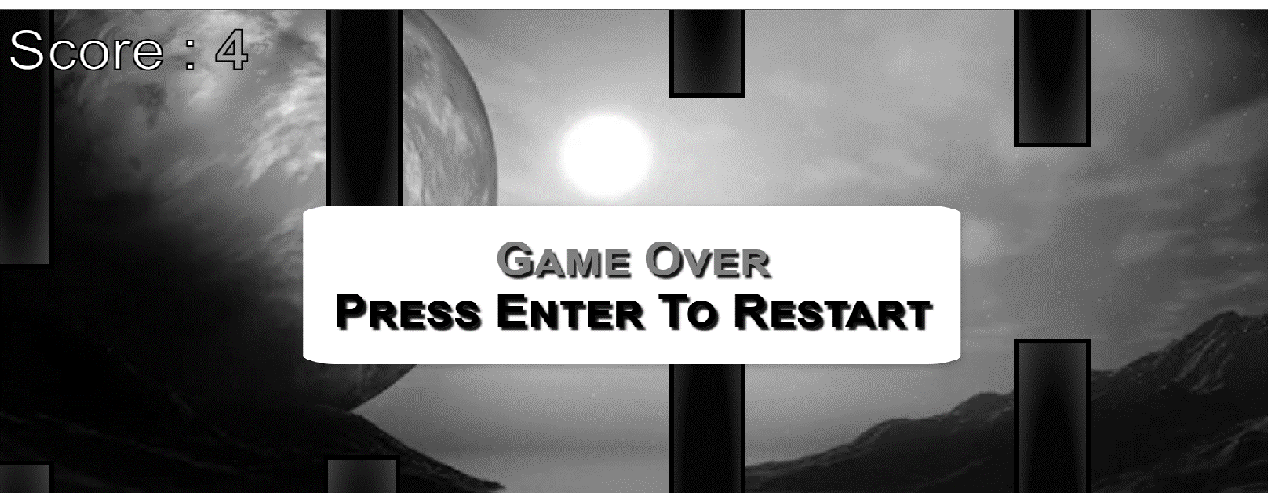
THE INTERFACE OF GAME

Slide 10
THE END ..

